Slide 1
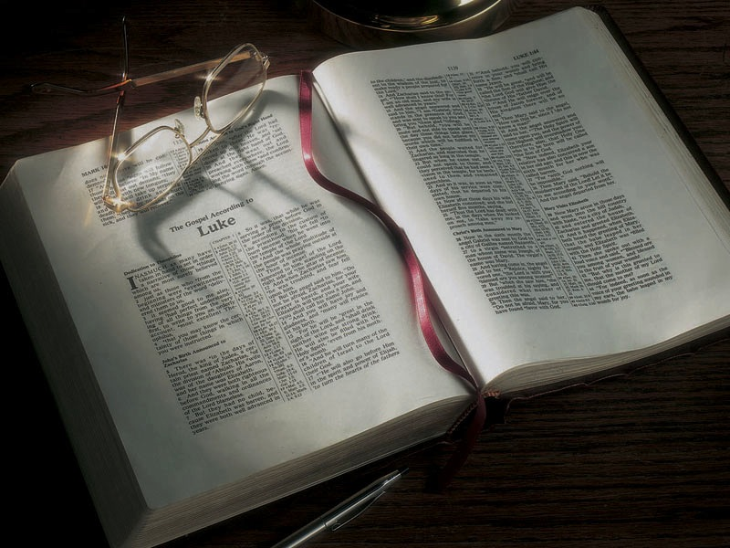

Slide 2
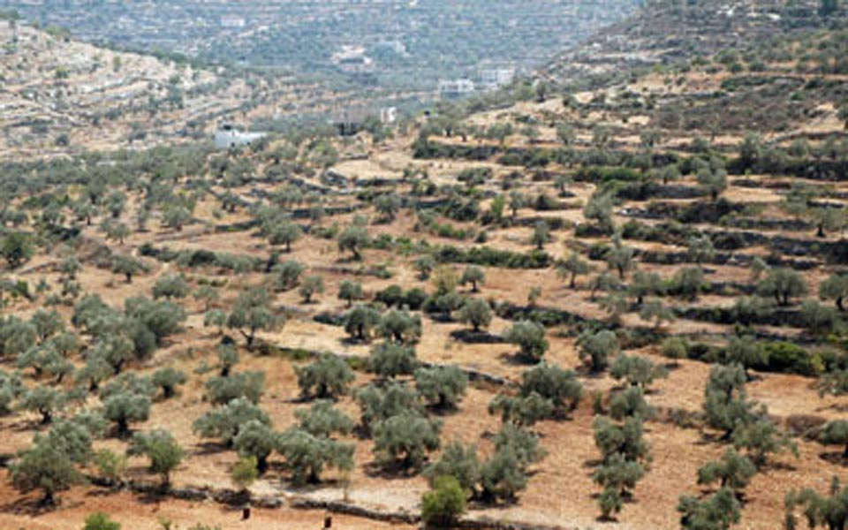

Slide 3
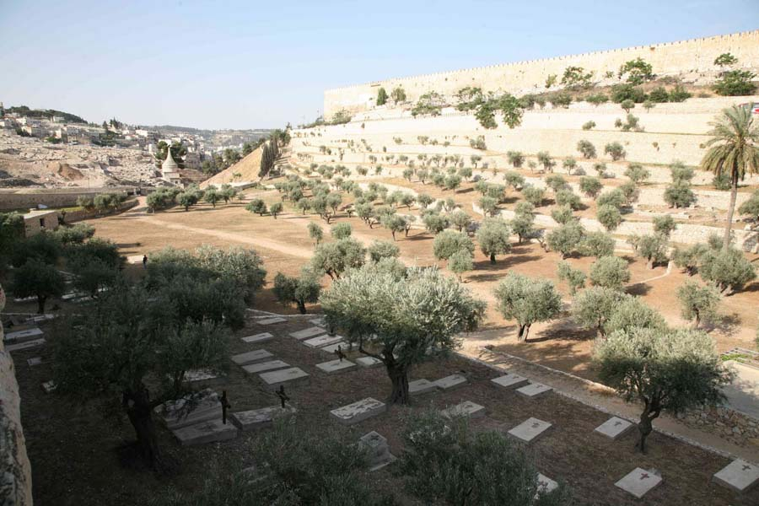

Slide 4
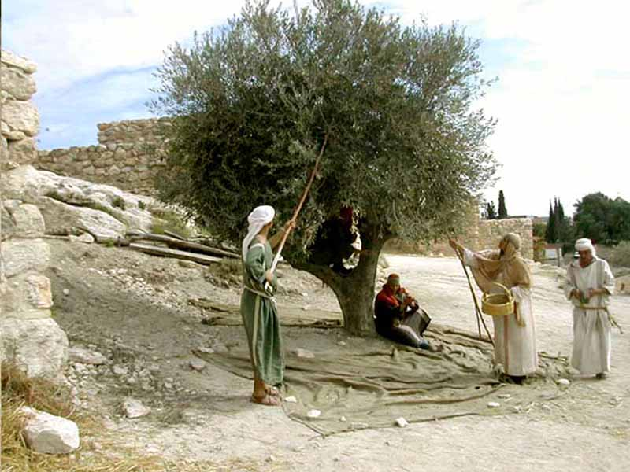

Slide 5
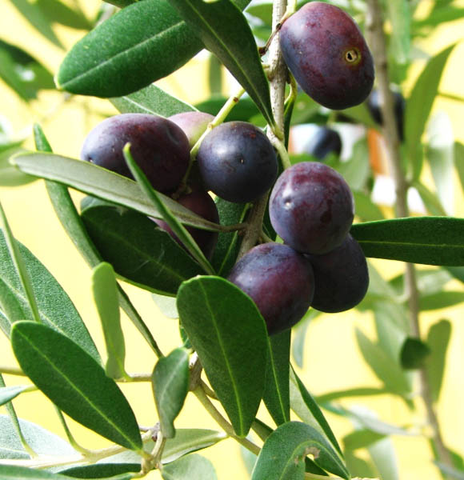

Slide 6
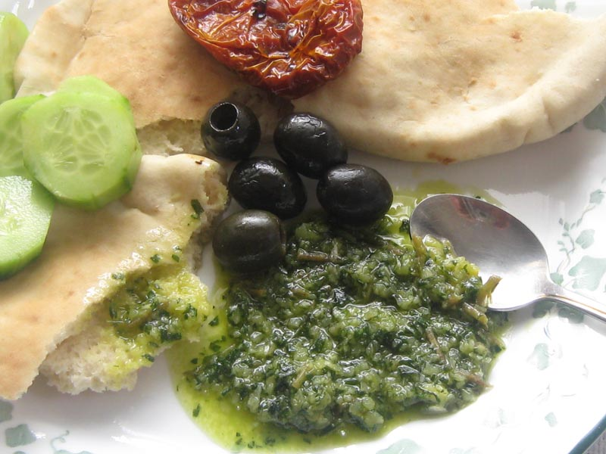

Slide 7
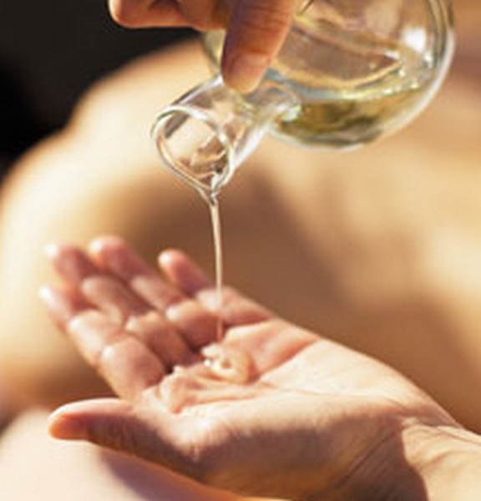

Slide 8
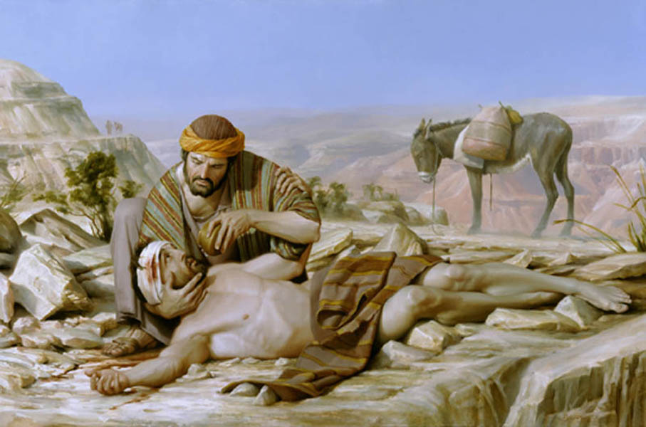

Slide 9
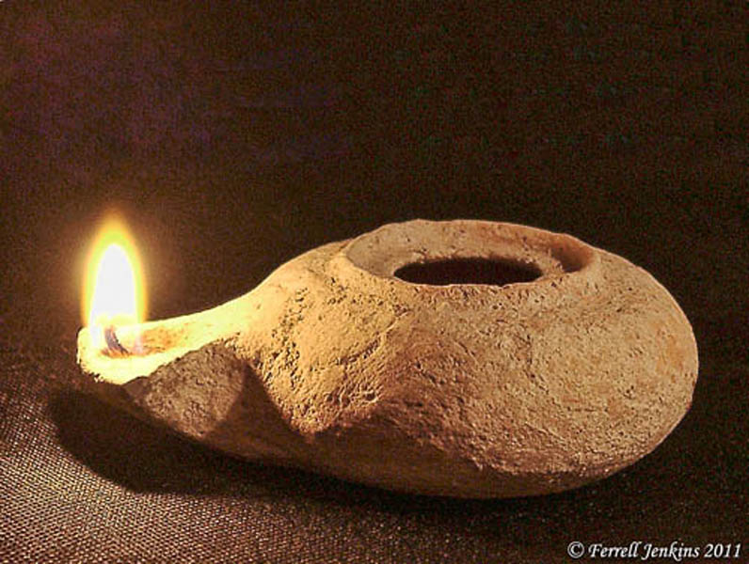

Slide 10
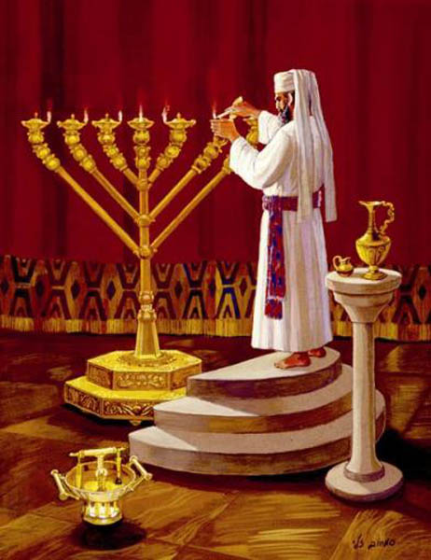

Slide 11
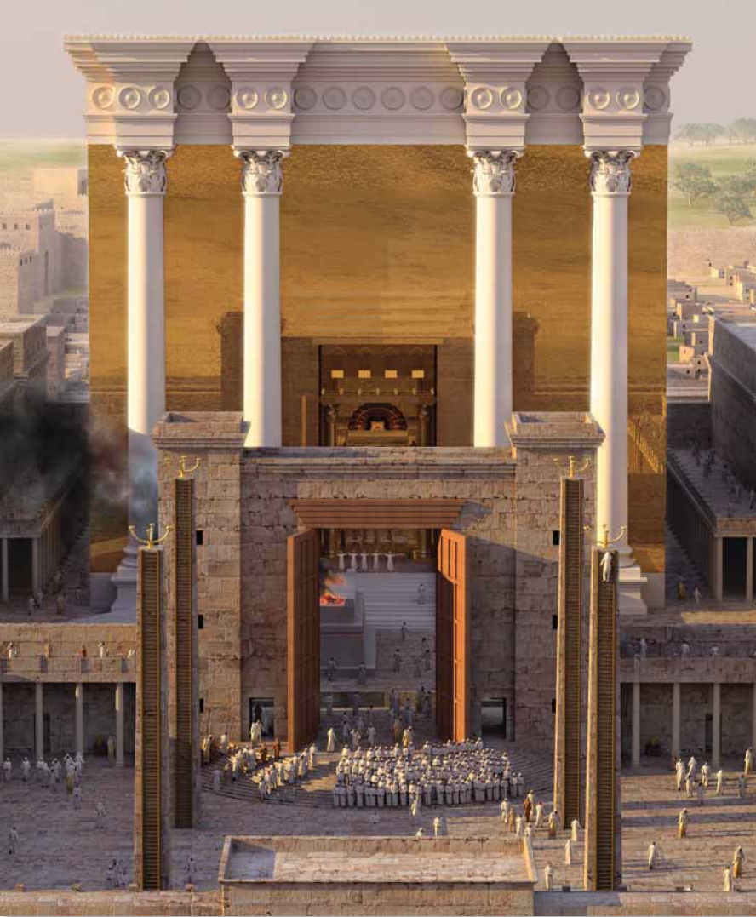

Slide 12
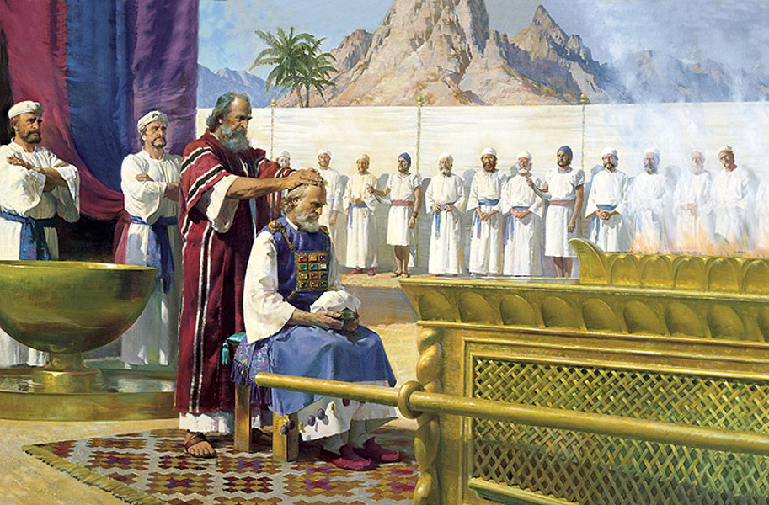

Slide 13
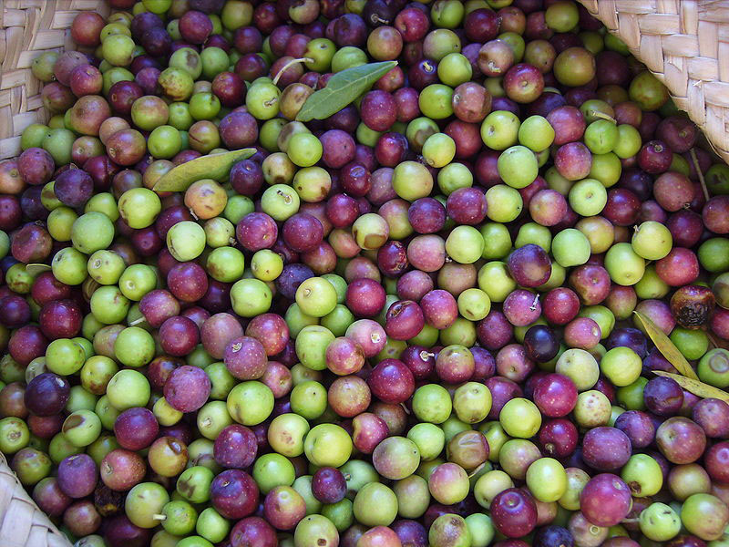

Slide 14
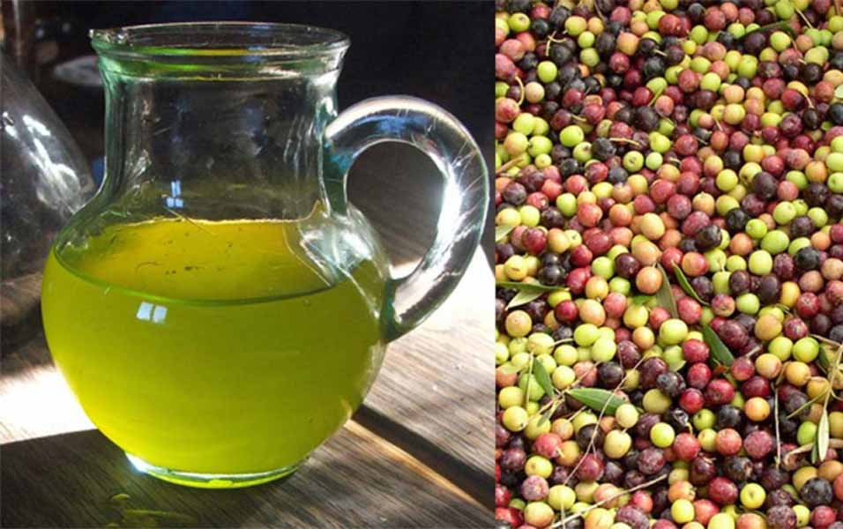

Slide 15
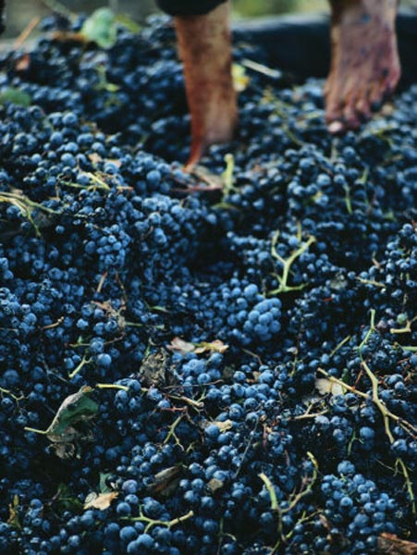

Slide 16
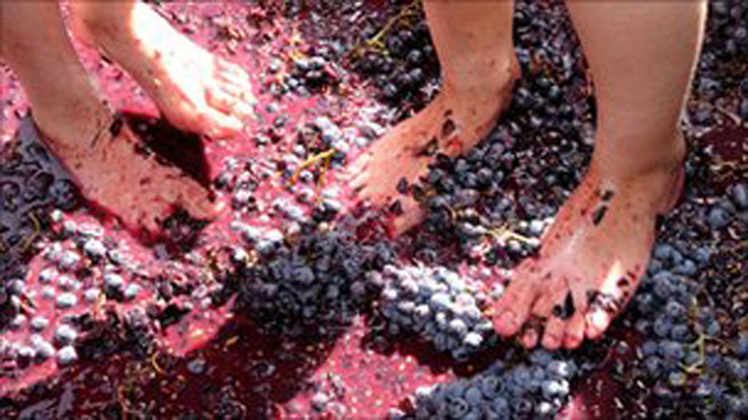

Slide 17
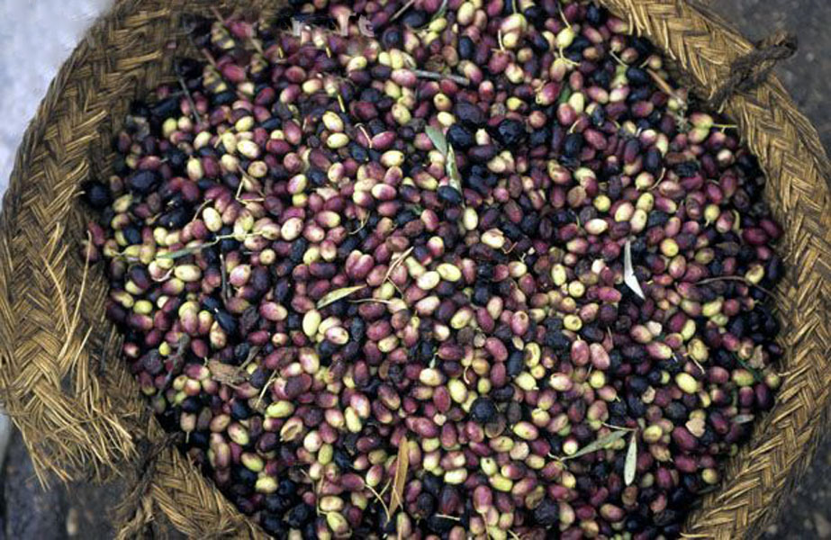

Slide 19
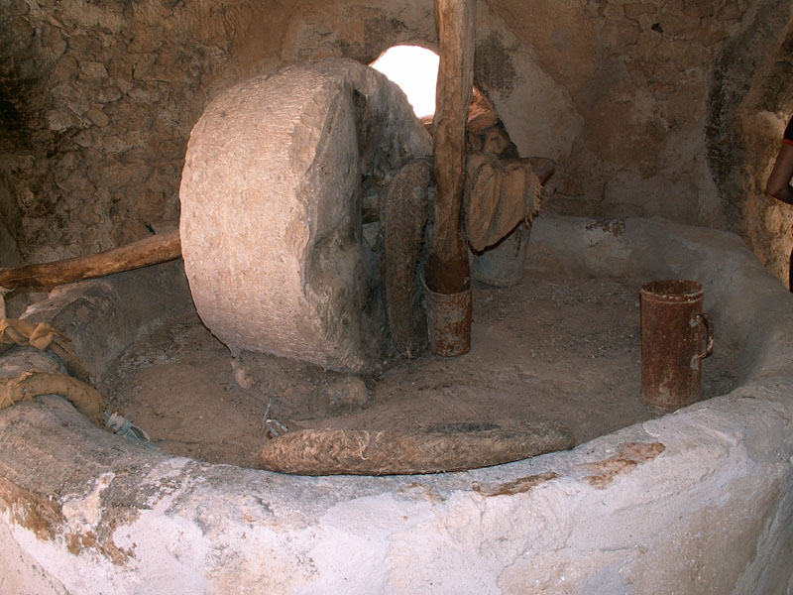

Slide 20
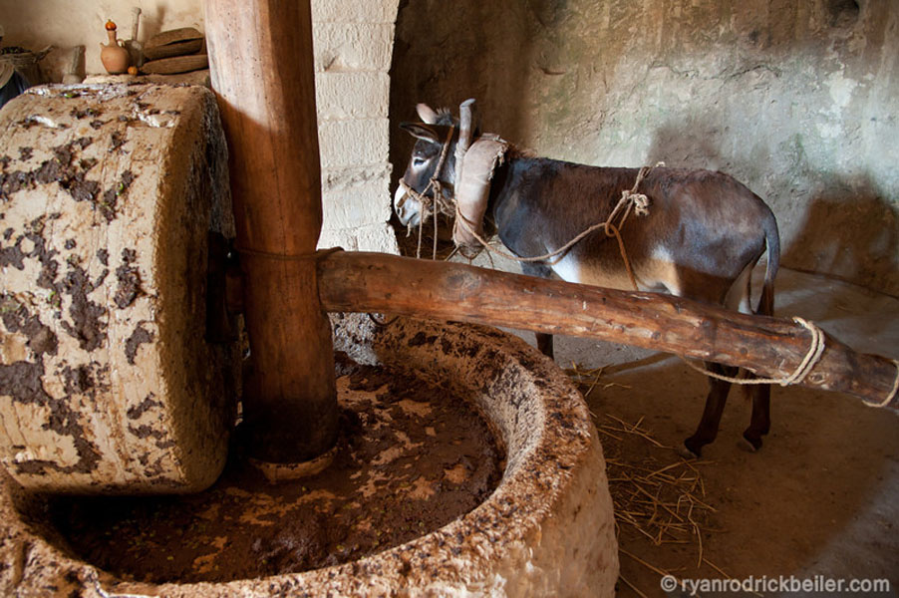

Slide 21
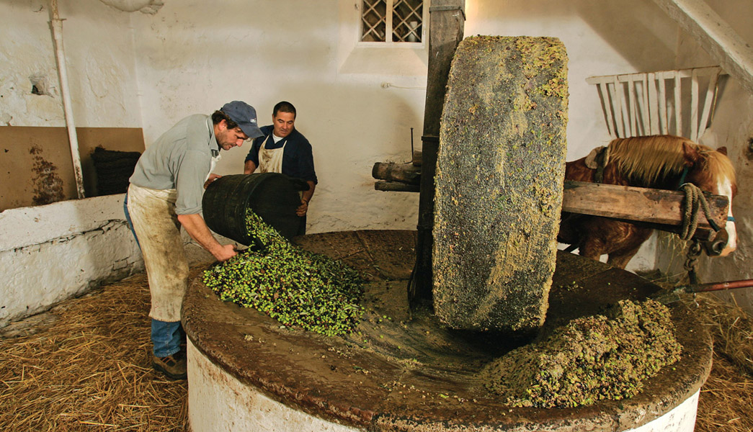

Slide 22
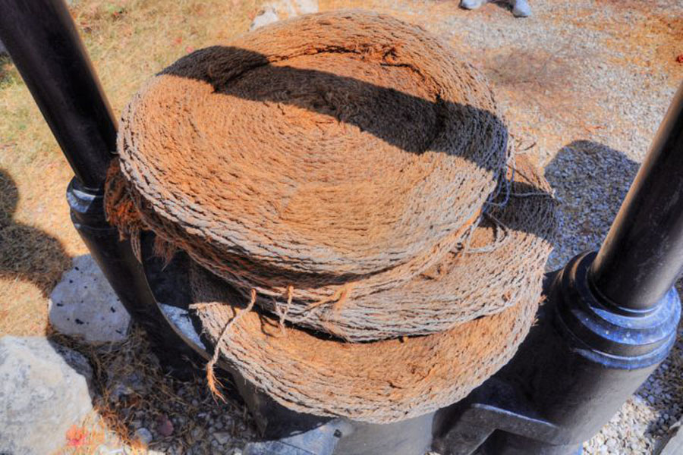

Slide 23
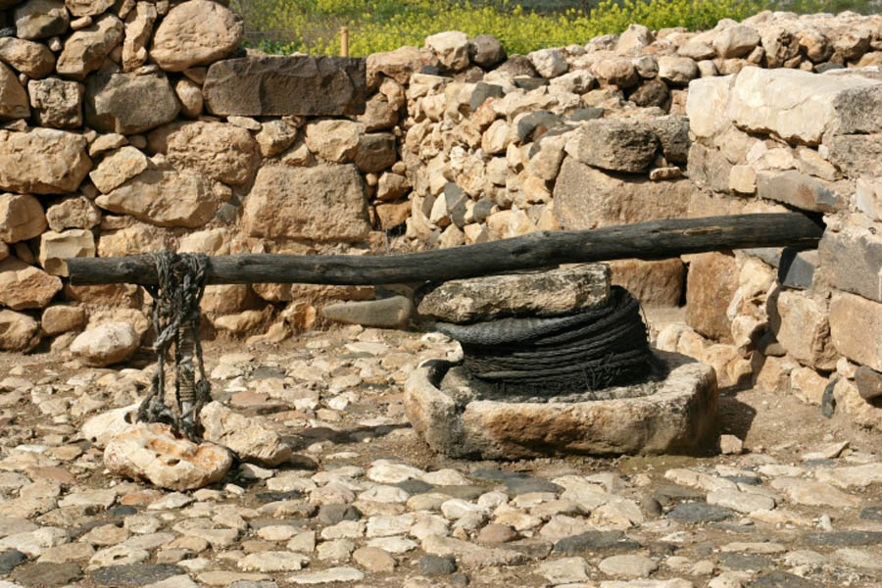

Slide 24
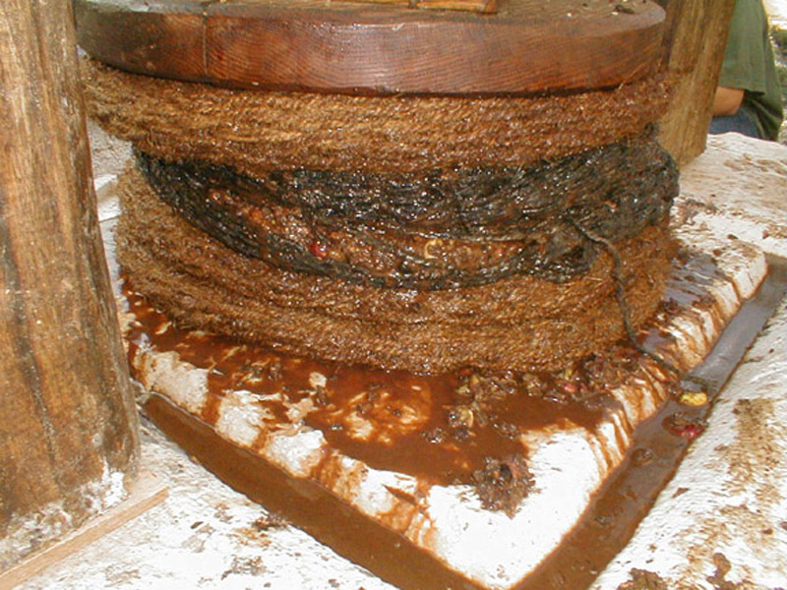

Slide 25
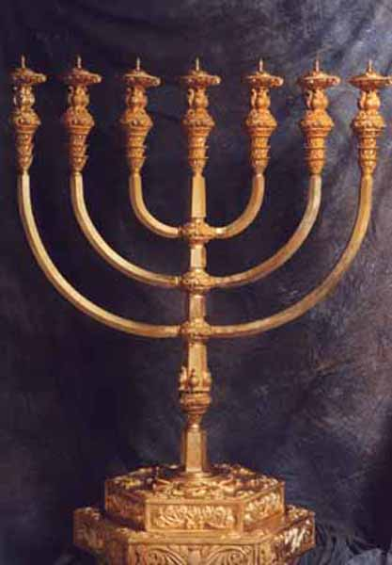

Slide 26
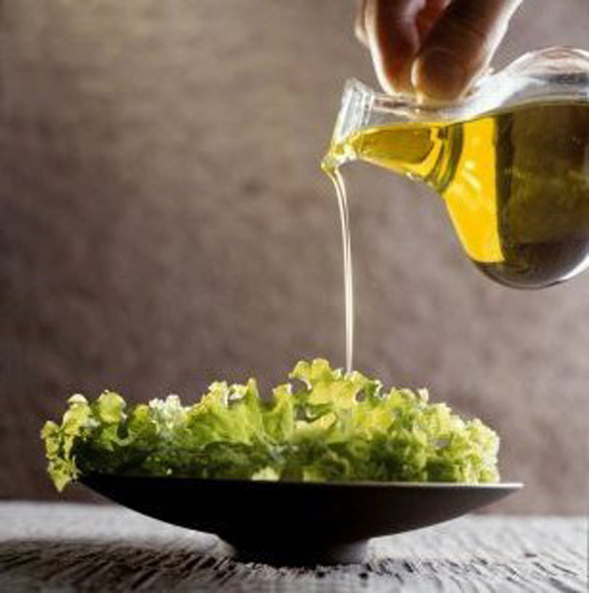

Slide 27
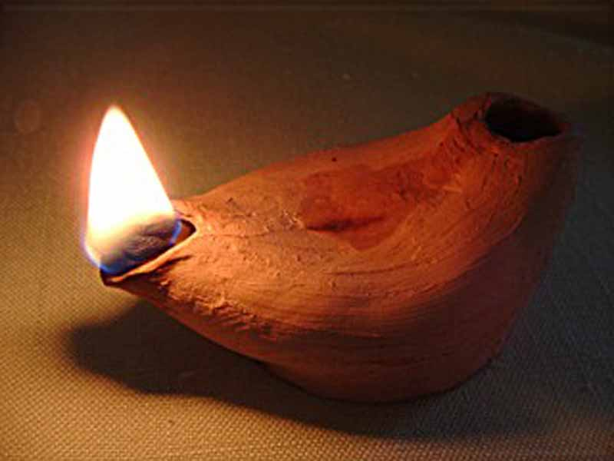

Slide 28
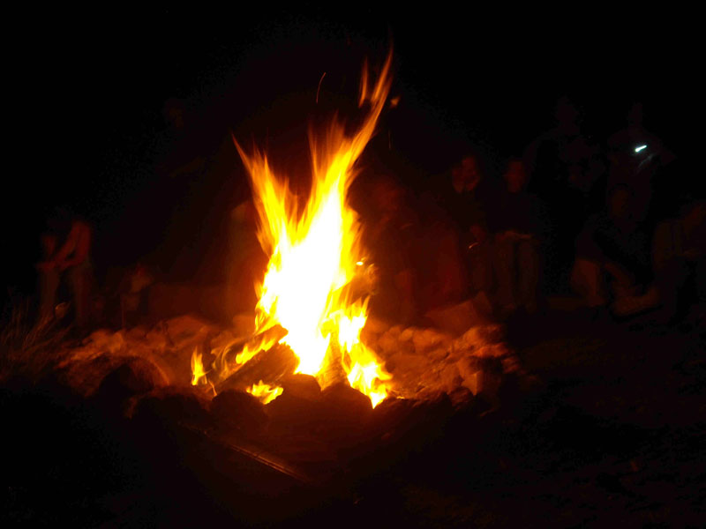

Slide 29
“Olive oil press” in Hebrew

Slide 30
Luke 1:26-56
“Olive oil press” in Hebrew
54 He has helped His servant Israel, In remembrance of His mercy,
55 As He spoke to our fathers, to Abraham and to his seed forever.”
Psalm 132:11 “The LORD has sworn in truth to David; He will not turn from it: “I will set upon your throne the fruit of your body.”
Gat, meaning “press”

Slide 31
Luke 1:26-56
“Olive oil press” in Hebrew
54 He has helped His servant Israel, In remembrance of His mercy,
55 As He spoke to our fathers, to Abraham and to his seed forever.”
Psalm 132:11 “The LORD has sworn in truth to David; He will not turn from it: “I will set upon your throne the fruit of your body.”
Gat, meaning “press”
Shemanin, meaning “oil”

Slide 32
Luke 1:26-56
“Olive oil press” in Hebrew
54 He has helped His servant Israel, In remembrance of His mercy,
55 As He spoke to our fathers, to Abraham and to his seed forever.”
Psalm 132:11 “The LORD has sworn in truth to David; He will not turn from it: “I will set upon your throne the fruit of your body.”
Gat, meaning “press”
Shemanin, meaning “oil”
= Gatshemanin

Slide 33
Luke 1:26-56
“Olive oil press” in Hebrew
54 He has helped His servant Israel, In remembrance of His mercy,
55 As He spoke to our fathers, to Abraham and to his seed forever.”
Psalm 132:11 “The LORD has sworn in truth to David; He will not turn from it: “I will set upon your throne the fruit of your body.”
Gat, meaning “press”
Shemanin, meaning “oil”
= Gatshemanin
Gethsemane

Slide 34
Luke 1:26-56
54 He has helped His servant Israel, In remembrance of His mercy,
55 As He spoke to our fathers, to Abraham and to his seed forever.”
Psalm 132:11 “The LORD has sworn in truth to David; He will not turn from it: “I will set upon your throne the fruit of your body.”
Lessons From
Gethsemane

Slide 35
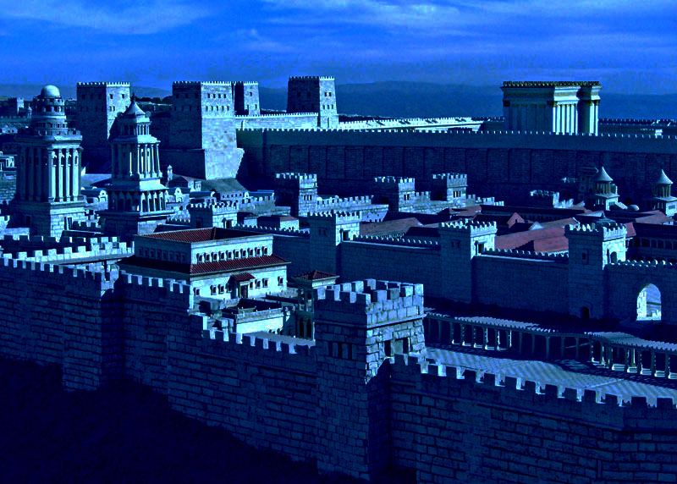

Slide 36
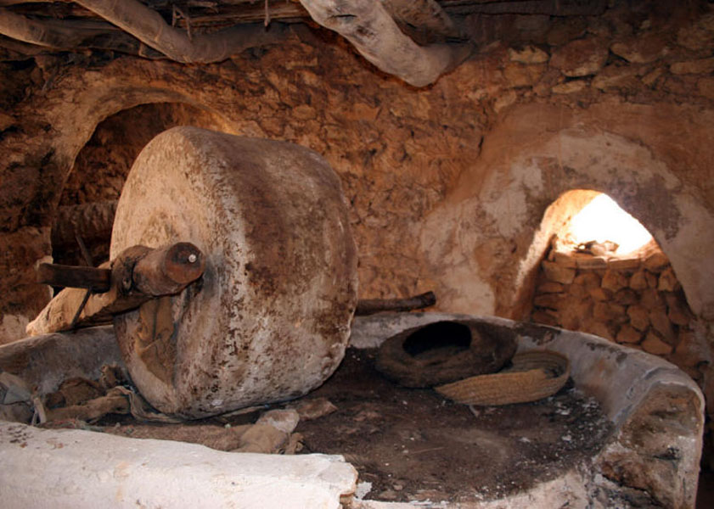

Slide 37
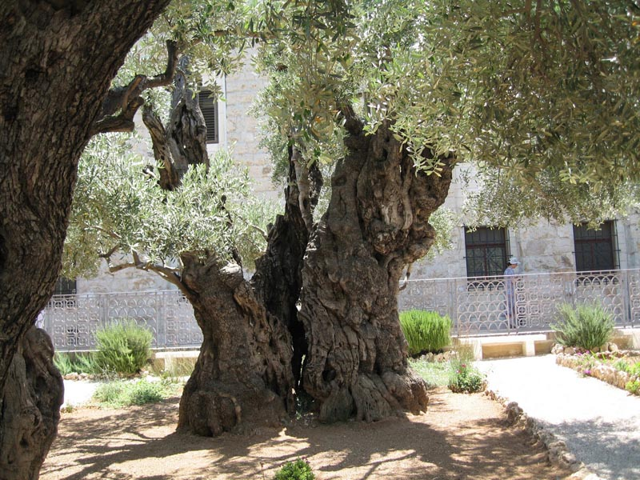

Slide 38
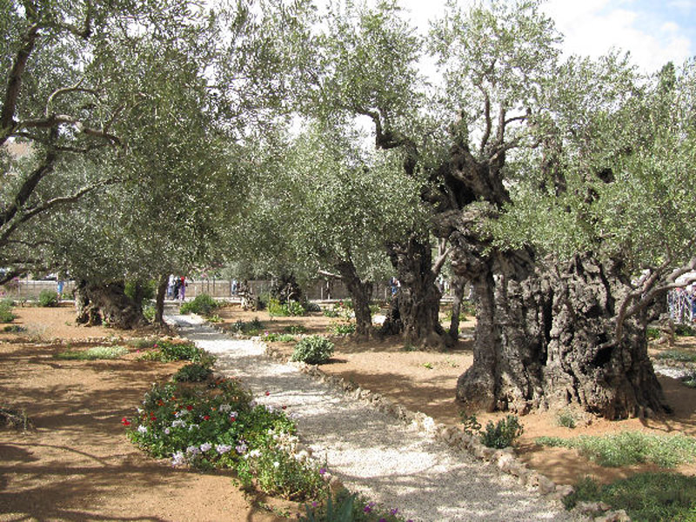

Slide 39
Luke 1:26-56
Mark 14:32
54 He has helped His servant Israel, In remembrance of His mercy,
55 As He spoke to our fathers, to Abraham and to his seed forever.”
Psalm 132:11 “The LORD has sworn in truth to David; He will not turn from it: “I will set upon your throne the fruit of your body.”
32 Then they came to a place which was named Gethsemane; and He said to His disciples, “Sit here while I pray.”

Slide 40
Luke 1:26-56
Matthew 20:18-19
54 He has helped His servant Israel, In remembrance of His mercy,
55 As He spoke to our fathers, to Abraham and to his seed forever.”
Psalm 132:11 “The LORD has sworn in truth to David; He will not turn from it: “I will set upon your throne the fruit of your body.”
18 “Behold, we are going up to Jerusalem, and the Son of Man will be betrayed to the chief priests and to the scribes; and they will condemn Him to death,
19 “and deliver Him to the Gentiles to mock and to scourge and to crucify. And the third day He will rise again.”

Slide 41
Luke 1:26-56
Matthew 26:2
54 He has helped His servant Israel, In remembrance of His mercy,
55 As He spoke to our fathers, to Abraham and to his seed forever.”
Psalm 132:11 “The LORD has sworn in truth to David; He will not turn from it: “I will set upon your throne the fruit of your body.”
2 “You know that after two days is the Passover, and the Son of Man will be delivered up to be crucified.”

Slide 42
Luke 1:26-56
Matthew 26:10-12
54 He has helped His servant Israel, In remembrance of His mercy,
55 As He spoke to our fathers, to Abraham and to his seed forever.”
Psalm 132:11 “The LORD has sworn in truth to David; He will not turn from it: “I will set upon your throne the fruit of your body.”
10 “Why do you trouble the woman? For she has done a good work for Me.
11 “For you have the poor with you always, but Me you do not have always.
12 “For in pouring this fragrant oil on My body, she did it for My burial.

Slide 43
Luke 1:26-56
Matthew 26:31-32
54 He has helped His servant Israel, In remembrance of His mercy,
55 As He spoke to our fathers, to Abraham and to his seed forever.”
Psalm 132:11 “The LORD has sworn in truth to David; He will not turn from it: “I will set upon your throne the fruit of your body.”
31 “All of you will be made to stumble because of Me this night, for it is written: ‘I will strike the Shepherd, And the sheep of the flock will be scattered.’
32 “But after I have been raised, I will go before you to Galilee.”

Slide 44
Luke 1:26-56
1 Corinthians 11:24-25
54 He has helped His servant Israel, In remembrance of His mercy,
55 As He spoke to our fathers, to Abraham and to his seed forever.”
Psalm 132:11 “The LORD has sworn in truth to David; He will not turn from it: “I will set upon your throne the fruit of your body.”
24 and when He had given thanks, He broke it and said, “Take, eat; this is My body which is broken for you; do this in remembrance of Me.”
25 In the same manner He also took the cup after supper, saying, “This cup is the new covenant in My blood. This do, as often as you drink it, in remembrance of Me.”

Slide 45
Luke 1:26-56
Mark 14:33
54 He has helped His servant Israel, In remembrance of His mercy,
55 As He spoke to our fathers, to Abraham and to his seed forever.”
Psalm 132:11 “The LORD has sworn in truth to David; He will not turn from it: “I will set upon your throne the fruit of your body.”
33 And He took Peter, James, and John with Him, and He began to be troubled and deeply distressed.

Slide 46
Luke 1:26-56
Mark 14:33
54 He has helped His servant Israel, In remembrance of His mercy,
55 As He spoke to our fathers, to Abraham and to his seed forever.”
Psalm 132:11 “The LORD has sworn in truth to David; He will not turn from it: “I will set upon your throne the fruit of your body.”
33 And He took Peter, James, and John with Him, and He began to be troubled and deeply distressed.
anguished, depressed, full of heaviness

Slide 47
Luke 1:26-56
What were the weights?
54 He has helped His servant Israel, In remembrance of His mercy,
55 As He spoke to our fathers, to Abraham and to his seed forever.”
Psalm 132:11 “The LORD has sworn in truth to David; He will not turn from it: “I will set upon your throne the fruit of your body.”

Slide 48
Luke 1:26-56
What were the weights?
54 He has helped His servant Israel, In remembrance of His mercy,
55 As He spoke to our fathers, to Abraham and to his seed forever.”
Psalm 132:11 “The LORD has sworn in truth to David; He will not turn from it: “I will set upon your throne the fruit of your body.”
• Rejected by His hometown of Nazareth

Slide 49
Luke 1:26-56
What were the weights?
54 He has helped His servant Israel, In remembrance of His mercy,
55 As He spoke to our fathers, to Abraham and to his seed forever.”
Psalm 132:11 “The LORD has sworn in truth to David; He will not turn from it: “I will set upon your throne the fruit of your body.”
• Rejected by His hometown of Nazareth
• Rejected by the towns where He taught

Slide 50
Luke 1:26-56
What were the weights?
54 He has helped His servant Israel, In remembrance of His mercy,
55 As He spoke to our fathers, to Abraham and to his seed forever.”
Psalm 132:11 “The LORD has sworn in truth to David; He will not turn from it: “I will set upon your throne the fruit of your body.”
• Rejected by His hometown of Nazareth
• Rejected by the towns where He taught
• Rejected by His beloved Jerusalem

Slide 51
Luke 1:26-56
What were the weights?
54 He has helped His servant Israel, In remembrance of His mercy,
55 As He spoke to our fathers, to Abraham and to his seed forever.”
Psalm 132:11 “The LORD has sworn in truth to David; He will not turn from it: “I will set upon your throne the fruit of your body.”
• Rejected by His hometown of Nazareth
• Rejected by the towns where He taught
• Rejected by His beloved Jerusalem
• Rejected by His half-brothers and sisters

Slide 52
Luke 1:26-56
What were the weights?
54 He has helped His servant Israel, In remembrance of His mercy,
55 As He spoke to our fathers, to Abraham and to his seed forever.”
Psalm 132:11 “The LORD has sworn in truth to David; He will not turn from it: “I will set upon your throne the fruit of your body.”
• Rejected by His hometown of Nazareth
• Rejected by the towns where He taught
• Rejected by His beloved Jerusalem
• Rejected by His half-brothers and sisters
• Soon to be rejected by His disciples

Slide 53
Luke 1:26-56
What were the weights?
54 He has helped His servant Israel, In remembrance of His mercy,
55 As He spoke to our fathers, to Abraham and to his seed forever.”
Psalm 132:11 “The LORD has sworn in truth to David; He will not turn from it: “I will set upon your throne the fruit of your body.”
• Rejected by His hometown of Nazareth
• Rejected by the towns where He taught
• Rejected by His beloved Jerusalem
• Rejected by His half-brothers and sisters
• Soon to be rejected by His disciples
• Soon to be denied by His dear friend Peter

Slide 54
Luke 1:26-56
What were the weights?
54 He has helped His servant Israel, In remembrance of His mercy,
55 As He spoke to our fathers, to Abraham and to his seed forever.”
Psalm 132:11 “The LORD has sworn in truth to David; He will not turn from it: “I will set upon your throne the fruit of your body.”
• Rejected by His hometown of Nazareth
• Rejected by the towns where He taught
• Rejected by His beloved Jerusalem
• Rejected by His half-brothers and sisters
• Soon to be rejected by His disciples
• Soon to be denied by His dear friend Peter
• Soon to face a sham trial

Slide 55
Luke 1:26-56
What were the weights?
54 He has helped His servant Israel, In remembrance of His mercy,
55 As He spoke to our fathers, to Abraham and to his seed forever.”
Psalm 132:11 “The LORD has sworn in truth to David; He will not turn from it: “I will set upon your throne the fruit of your body.”
• Rejected by His hometown of Nazareth
• Rejected by the towns where He taught
• Rejected by His beloved Jerusalem
• Rejected by His half-brothers and sisters
• Soon to be rejected by His disciples
• Soon to be denied by His dear friend Peter
• Soon to face a sham trial
• Soon to be condemned by the Romans

Slide 56
Luke 1:26-56
What were the weights?
54 He has helped His servant Israel, In remembrance of His mercy,
55 As He spoke to our fathers, to Abraham and to his seed forever.”
Psalm 132:11 “The LORD has sworn in truth to David; He will not turn from it: “I will set upon your throne the fruit of your body.”
• Rejected by His hometown of Nazareth
• Rejected by the towns where He taught
• Rejected by His beloved Jerusalem
• Rejected by His half-brothers and sisters
• Soon to be rejected by His disciples
• Soon to be denied by His dear friend Peter
• Soon to face a sham trial
• Soon to be condemned by the Romans
• Soon to be bruised and disfigured disfigured beyond recognition as a human being

Slide 57
Luke 1:26-56
What were the weights?
54 He has helped His servant Israel, In remembrance of His mercy,
55 As He spoke to our fathers, to Abraham and to his seed forever.”
Psalm 132:11 “The LORD has sworn in truth to David; He will not turn from it: “I will set upon your throne the fruit of your body.”
• Rejected by His hometown of Nazareth
• Rejected by the towns where He taught
• Rejected by His beloved Jerusalem
• Rejected by His half-brothers and sisters
• Soon to be rejected by His disciples
• Soon to be denied by His dear friend Peter
• Soon to face a sham trial
• Soon to be condemned by the Romans
• Soon to be bruised and disfigured beyond recognition as a human being
• Soon to be ridiculed and humiliated, spat upon

Slide 58
Luke 1:26-56
What were the weights?
54 He has helped His servant Israel, In remembrance of His mercy,
55 As He spoke to our fathers, to Abraham and to his seed forever.”
Psalm 132:11 “The LORD has sworn in truth to David; He will not turn from it: “I will set upon your throne the fruit of your body.”
• Soon to be sacrificed as the Lamb of God

Slide 59
Luke 1:26-56
What were the weights?
54 He has helped His servant Israel, In remembrance of His mercy,
55 As He spoke to our fathers, to Abraham and to his seed forever.”
Psalm 132:11 “The LORD has sworn in truth to David; He will not turn from it: “I will set upon your throne the fruit of your body.”
• Soon to be sacrificed as the Lamb of God
• He, the Creator and Lifegiver, would soon die

Slide 60
Luke 1:26-56
What were the weights?
54 He has helped His servant Israel, In remembrance of His mercy,
55 As He spoke to our fathers, to Abraham and to his seed forever.”
Psalm 132:11 “The LORD has sworn in truth to David; He will not turn from it: “I will set upon your throne the fruit of your body.”
• Soon to be sacrificed as the Lamb of God
• He, the Creator and Lifegiver, would soon die
• The weight of the world was upon Him

Slide 61
Luke 1:26-56
Luke 22:41-44
54 He has helped His servant Israel, In remembrance of His mercy,
55 As He spoke to our fathers, to Abraham and to his seed forever.”
Psalm 132:11 “The LORD has sworn in truth to David; He will not turn from it: “I will set upon your throne the fruit of your body.”
41 And He was withdrawn from them about a stone’s throw, and He knelt down and prayed,
42 saying, “Father, if it is Your will, take this cup away from Me; nevertheless not My will, but Yours, be done.”
43 Then an angel appeared to Him from heaven, strengthening Him.
44 And being in agony, He prayed more earnestly.
Then His sweat became like great drops of blood falling down to the ground.

Slide 62
Luke 1:26-56
Luke 22:41-44
54 He has helped His servant Israel, In remembrance of His mercy,
55 As He spoke to our fathers, to Abraham and to his seed forever.”
Psalm 132:11 “The LORD has sworn in truth to David; He will not turn from it: “I will set upon your throne the fruit of your body.”
41 And He was withdrawn from them about a stone’s throw, and He knelt down and prayed,
42 saying, “Father, if it is Your will, take this cup away from Me; nevertheless not My will, but Yours, be done.”
43 Then an angel appeared to Him from heaven, strengthening Him.
44 And being in agony, He prayed more earnestly.
Then His sweat became like great drops of blood falling down to the ground. = haematidrosis

Slide 64
Luke 1:26-56
Mark 14:34
54 He has helped His servant Israel, In remembrance of His mercy,
55 As He spoke to our fathers, to Abraham and to his seed forever.”
Psalm 132:11 “The LORD has sworn in truth to David; He will not turn from it: “I will set upon your throne the fruit of your body.”
34 Then He said to them, “My soul is exceedingly sorrowful, even to death. Stay here and watch.”
35 He went a little farther, and fell on the ground, and prayed that if it were possible, the hour might pass from Him.
36 And He said, “Abba, Father, all things are possible for You. Take this cup away from Me; nevertheless, not what I will, but what You will.”

Slide 65
Luke 1:26-56
1 Peter 3:18
54 He has helped His servant Israel, In remembrance of His mercy,
55 As He spoke to our fathers, to Abraham and to his seed forever.”
Psalm 132:11 “The LORD has sworn in truth to David; He will not turn from it: “I will set upon your throne the fruit of your body.”
18 For Christ died for sins once for all, the righteous for the unrighteous, to bring you to God. (NIV)

Slide 70
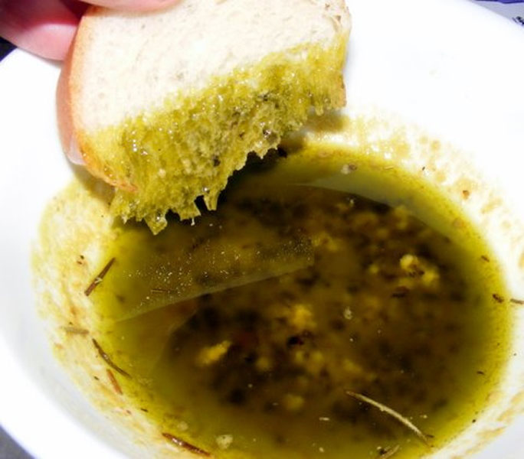

Slide 74
Luke 1:26-56
Mark 14:37-39
54 He has helped His servant Israel, In remembrance of His mercy,
55 As He spoke to our fathers, to Abraham and to his seed forever.”
Psalm 132:11 “The LORD has sworn in truth to David; He will not turn from it: “I will set upon your throne the fruit of your body.”
37 Then He came and found them sleeping, and said to Peter, “Simon, are you sleeping? Could you not watch one hour?
38 “Watch and pray, lest you enter into temptation. The spirit indeed is willing, but the flesh is weak.”
39 Again He went away and prayed, and spoke the same words.

Slide 75
Luke 1:26-56
Mark 14:37-39
54 He has helped His servant Israel, In remembrance of His mercy,
55 As He spoke to our fathers, to Abraham and to his seed forever.”
Psalm 132:11 “The LORD has sworn in truth to David; He will not turn from it: “I will set upon your throne the fruit of your body.”
37 Then He came and found them sleeping, and said to Peter, “Simon, are you sleeping? Could you not watch one hour?
38 “Watch and pray, lest you enter into temptation. The spirit indeed is willing, but the flesh is weak.”
Again He went away and prayed, and spoke
the same words.
“Abba, Father . . . Take this cup away from Me; nevertheless, not what I will, but what You will.”

Slide 76
Luke 1:26-56
John 10:17-18
54 He has helped His servant Israel, In remembrance of His mercy,
55 As He spoke to our fathers, to Abraham and to his seed forever.”
Psalm 132:11 “The LORD has sworn in truth to David; He will not turn from it: “I will set upon your throne the fruit of your body.”
17 “Therefore My Father loves Me, because I lay down My life that I may take it again.
18 “No one takes it from Me, but I lay it down of Myself.

Slide 77
Luke 1:26-56
Mark 14:40
54 He has helped His servant Israel, In remembrance of His mercy,
55 As He spoke to our fathers, to Abraham and to his seed forever.”
Psalm 132:11 “The LORD has sworn in truth to David; He will not turn from it: “I will set upon your throne the fruit of your body.”
40 And when He returned, He found them asleep again, for their eyes were heavy; and they did not know what to answer Him.
41 Then He came the third time and said to them, “Are you still sleeping and resting? It is enough! The hour has come; behold, the Son of Man is being betrayed into the hands of sinners.
42 “Rise, let us be going. See, My betrayer is at hand.”

Slide 78
Luke 1:26-56
John 18:2-9
54 He has helped His servant Israel, In remembrance of His mercy,
55 As He spoke to our fathers, to Abraham and to his seed forever.”
Psalm 132:11 “The LORD has sworn in truth to David; He will not turn from it: “I will set upon your throne the fruit of your body.”
2 And Judas, who betrayed Him, also knew the place; for Jesus often met there with His disciples.
3 Then Judas, having received a detachment of troops, and officers from the chief priests and Pharisees, came there with lanterns, torches, and weapons.
4 Jesus therefore, knowing all things that would come upon Him, went forward and said to them, “Whom are you seeking?”

Slide 79
Luke 1:26-56
John 18:2-9
54 He has helped His servant Israel, In remembrance of His mercy,
55 As He spoke to our fathers, to Abraham and to his seed forever.”
Psalm 132:11 “The LORD has sworn in truth to David; He will not turn from it: “I will set upon your throne the fruit of your body.”
5 They answered Him, “Jesus of Nazareth.” Jesus said to them, “I am He.” And Judas, who betrayed Him, also stood with them.
6 Now when He said to them, “I am He,” they drew back and fell to the ground.
7 Then He asked them again, “Whom are you seeking?” And they said, “Jesus of Nazareth.”
8 Jesus answered, “I have told you that I am He. Therefore, if you seek Me, let these go their way,”
9 that the saying might be fulfilled which He spoke, “Of those whom You gave Me I have lost none.”

Slide 80
Luke 1:26-56
Matthew 26:48-56
54 He has helped His servant Israel, In remembrance of His mercy,
55 As He spoke to our fathers, to Abraham and to his seed forever.”
Psalm 132:11 “The LORD has sworn in truth to David; He will not turn from it: “I will set upon your throne the fruit of your body.”
48 Now His betrayer [Judas Iscariot] had given them a sign, saying, “Whomever I kiss, He is the One; seize Him.”
49 Immediately he went up to Jesus and said, “Greetings, Rabbi!” and kissed Him.
50 But Jesus said to him, “Friend, why have you come?”
…
56 “But all this was done that the Scriptures of the prophets might be fulfilled.” Then all the disciples forsook Him and fled.

Slide 81
Luke 1:26-56
Zechariah 14:4-9
54 He has helped His servant Israel, In remembrance of His mercy,
55 As He spoke to our fathers, to Abraham and to his seed forever.”
Psalm 132:11 “The LORD has sworn in truth to David; He will not turn from it: “I will set upon your throne the fruit of your body.”
4 And in that day His feet will stand on the Mount of Olives, which faces Jerusalem on the east. And the Mount of Olives shall be split in two, from east to west, making a very large valley; half of the mountain shall move toward the north and half of it toward the south. …
8 And in that day it shall be that living waters shall flow from Jerusalem, half of them toward the eastern sea and half of them toward the western sea; in both summer and winter it shall occur.
9 And the LORD shall be King over all the earth.

Slide 82
Gethsemane: the olive press

